Slide 1
Transforming healthcare with augmented intelligence JD Blackwood Healthcare AI Lead, Scottish Government CTO and NHS National Programme Manager, iCAIRD
Notes:
Hi everyone. My name is James Blackwood, but most people just call me JD
I'm the CTO and NHS National Programme Manager for an Innovate UK research programme based in Scotland, called iCAIRD. iCAIRD is the largest healthcare AI programme in the UK, with over 40 partners and 40 research projects across radiology and pathology. We're a double award-winning programme and we've attracted over £25m in funding to-date.
I'm also the healthcare AI lead for the Scottish Government, where I'm responsible for establishing Scotland's AI Hub that provides education, infrastructure, platforms, advisory services, standards and funding for the national adoption of AI within NHS Scotland.
I'm genuinely excited to share more about the world of AI in healthcare, but remember that this is my first insurance event, so be gentle. I should point out that I'm not a clinician and I only came into healthcare 3.5 years ago.
Now, normally I try to inject some humour into my presentations and I asked my team to scour the internet to find me some witty one-liners about insurance - they came up with nothing. So I'm going to play this with a straight bat and today I hope to give you a snapshot of what AI is, why we need it and the reality of AI adoption in the UK health and care system…and maybe afterwards you can share some of those witty insurance anecdotes with me!

Slide 2
What is (not) AI?
Notes:
Now, before we delve into the application of AI, I thought we could start with a definition of AI and in particular what AI is not!

Slide 3
Notes:
It's not the terminator. I know that'll come as a disappointment to some of you, but AI has not reached a level of advancement where it's decided that the only way to save the human race is to destroy it.

Slide 4
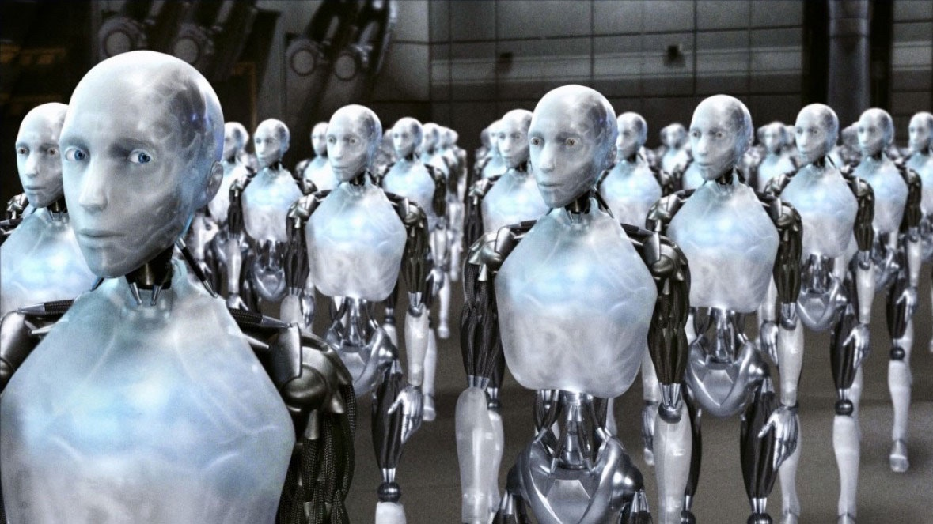
Notes:
AI is not sentient. i-Robot was a great movie, if a little sinister, but it's fantasy.

Slide 5
Notes:
Ahhh…Ultron… for the Marvel fans. We won't be transplanting your consciousness into a power-hungry advanced cybernetic device, at least not any time soon.

Slide 6
Notes:
And for those of a certain age. HAL from 2001 a space odyssey. No need to worry, you won't find your VR headset ejecting you into space or refusing to open the pod bay door!
All of these cinematic manifestations of AI are based on a concept called Big AI or Generalised Artificial intelligence. It doesn't yet exist and we're some way from achieving it. I'd be surprised if we achieve it within my lifetime.

Slide 7
What is AI?
Notes:
So, if that's not AI, what exactly is AI

Slide 8
Technologies used to allow computers to perform tasks that would otherwise require human intelligence, such as visual perception, speech recognition, and language translation
Scotland’s AI Strategy
Systems that display intelligent behaviour by analysing their environment and taking actions – with some degree of autonomy – to achieve specific goals
High-level Expert Group on AI, European Commission
The use of digital technology to create systems capable of performing tasks commonly thought to require human intelligence.
Office for Artificial Intelligence, UK Government
Notes:
There are lots of definitions for artificial intelligence. Here are some of the most common.
If you boil it down, AI is technology that's used to perform tasks commonly thought to require human intelligence. Visual perception. Emotion. Language. Reasoning.

Slide 9
AUGMENTED INTELLIGENCE
Machines using statistics to recognise patterns in large amounts of data, including those not perceptible by humans
Performs repetitive tasks with data, without the need for constant human guidance
Mostly ‘machine learning’ – digital systems that improve their performance at a particular task over time, through experience
Supplements rather than supplants
Notes:
We have to be very careful how we talk about artificial intelligence. I've spoken with a lot of clinicians and patients, and for some, the terminology is frightening. They see it as a metaphor for losing control of decisions or even losing their livelihoods.
A better way to think of AI is as augmented intelligence. In healthcare terms, it largely provides clinical or operational decision support, where the clinician or manager remains in control. Another way to think of it is software that simply automates mundane, time-consuming or exceptionally difficult tasks, to free you to apply their skills in more productive ways. It supplements rather than supplants the human.
AI is basically a very smart machine that uses statistics to infer patterns from large amounts of data, sometimes in ways that are faster than humans and sometimes in ways that can't be achieved by humans. And it does so with the minimum of human supervision.
You'll hear terns such as machine learning, deep learning, neural networks, natural language processing, etc. Most AI has to be taught by a human expert, on huge volumes of data until it becomes proficient at performing a task…and it can get better at that task by continuously learning from the data it consumes.

Slide 10
AI CANNOT
Be imaginative
Perform well without large amounts of highly-relevant data
Infer additional context if the information isn’t present in the data
Notes:
However, AI can't be imaginative. It can't infer additional context unless it's within the substantial amounts of data that it has trained with. I'm not saying that AI is stupid, but rather that it is very good at solving very specific problems.

Slide 11
Notes:
That being said here are two commonly quoted problems that AI finds surprisingly difficult. On the left, it can sometimes fail to recognise the difference between a chihuahua and a muffin. On the right it can struggle to differentiate between a sheepdog and a mop.
At this point, some of you may be rightly concerned that if AI can’t recognise the difference between a dog and a cake, then we’re all in trouble.
What I’m saying is that AI is currently very good at solving the specific problem for which it was trained. It takes a long time to train AI, a lot of data and a lot of clinician time – because like a child needs to be taught maths by a teacher, so AI needs to be taught how to recognise cancer by a clinician. You'll be pleased to hear, that with enough data and training, AI will help you avoid mopping the floor with your dog, or accidentally eating your chihuahua.
The point here is that the market is full of niche solutions that are really good at solving specific problems – such as recognising lung cancer on a chest x-ray. To apply AI across an entire clinical pathway, you’d need to purchase potentially dozens of these tools. You can't just buy AI, plug it in and the whole clinical pathway is magically transformed. Any AI tool on the market right now will make a substantial difference , but they're not necessarily easy to implement, or orchestrate across a pathway.

Slide 12
AI is often a medical device
If it’s used to treat, diagnose, cure, mitigate, or prevent disease or other conditions – it’s normally classified as a medical device
Just like any other medical device, it needs to be regulated, calibrated, monitored, maintained and controlled
Notes:
And one of the reasons for this is that AI isn't simply software. It's often - but not always - a medical device, just like an MRI or a CT scanner. And just like any other medical device, AI needs to be regulated, calibrated, monitored, maintained and controlled to ensure clinical safety and performance.
Helpfully the FDA have a very simple, high level list of criteria to determine whether your use of AI makes it a medical device. Basically, If it's used to treat, diagnose, cure, mitigate or prevent disease or other conditions - then it's a medical device.

Slide 13
Why might we need AI?
Notes:
So why do we need AI.

Slide 14
The system is overloaded
Outpatients should be seen <12 weeks after referral
Wait <12 weeks from decision to treat, to treatment
Begin treatment within 18 weeks of referral
95%
49.6%
100%
63.9%
90%
72.8%
Target
Actual
Target
Actual
Target
Actual
Wait <62 days from urgent suspicion of cancer referral to treatment
Wait <31 days from decision to treat cancer, to treatment
Wait <6 weeks for key diagnostic tests
95%
76.9%
95%
96.3%
100%
49.6%
Target
Actual
Target
Actual
Target
Actual
ED admission, transfer or discharge within 4 hours of reception
100%
71.3%
Target
Actual
Notes:
I suspect everybody in the room instinctively knows why. These are NHS Scotland performance statistics from a couple of months ago. We're missing national performance targets by anywhere from 20 to 50 percentage points and the situation looks similar across the UK.
In general, we're not seeing patients quickly enough, treating them quickly enough or discharging them quickly enough. Some patients are waiting longer than 2 years for treatment, even if they're diagnosed with a life threatening or life altering disease such as cancer.

Slide 15
A PERFECT STORM
Targets are being missed
Financial constraints
Workforce pressures
Demand is increasing
Improved outcomes
Demand will increase by a further 60% by 2040
This demand cannot be met by human resource alone
Notes:
The context to these statistics is fairly grim.
We're under extreme financial pressure, with ongoing targets for annualised cost reduction. In some areas, especially imaging disciplines, over a third of positions remain unfilled a year after they were advertised, and those who are doing the job, are burning out at record levels.
Staff within the NHS are trying their hardest in difficult circumstances to achieve the best possible outcomes for their patients and to cope with unprecedented demand; demand that will increase by 60% over the next two decades.
This is not a problem that can be resolved by human resources alone. There aren't enough people and we don't have enough money.
It needs the assistance of digital health technology, especially augmented intelligence.

Slide 16
Where can it be used?
Notes:
So where can we use AI

Slide 17
Population health and prevention
Operational planning, scheduling and prioritisation
Quality, information, security and safety management
Demand forecasting
Diagnostics
Diagnosis
Prediction and prognosis
Therapeutic
Screening
Notes:
It probably won't surprise you to learn that AI can be used in almost any aspect of clinical care, including the operational management of a hospital.
Today, I want to give you a broad appreciation of how AI in being actively used in Healthcare around the world, including some examples from right here in Scotland

Slide 18
Breast cancer screening
Notes:
There have been decades of research into image recognition using AI. Facial recognition for security. Object recognition for self-driving cars. Motion tracking for defence applications. Computer vision is where the money has been, so it's a mature use of augmented intelligence.
It should come as no surprise then, that many of the at-market AI solutions are designed to interpret diagnostic imaging. There are over 300 AI products in the diagnostic imaging space, and the majority interpret radiological images.

Slide 19
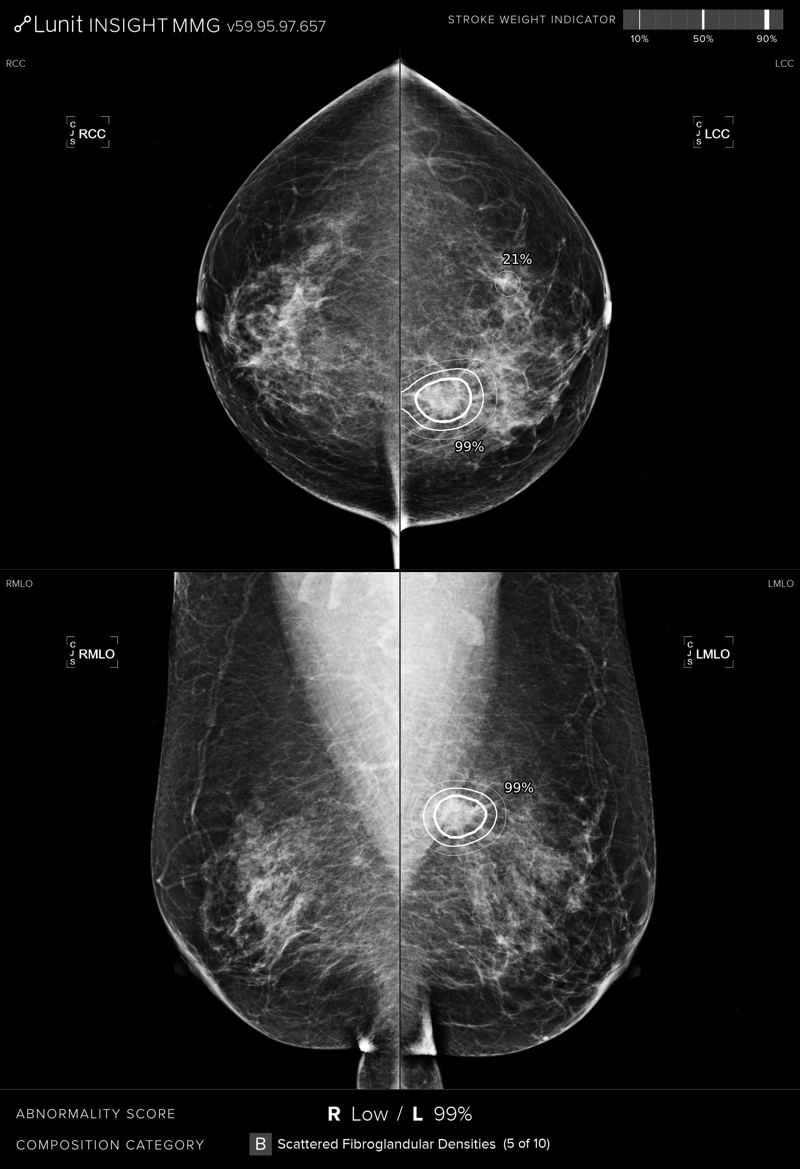
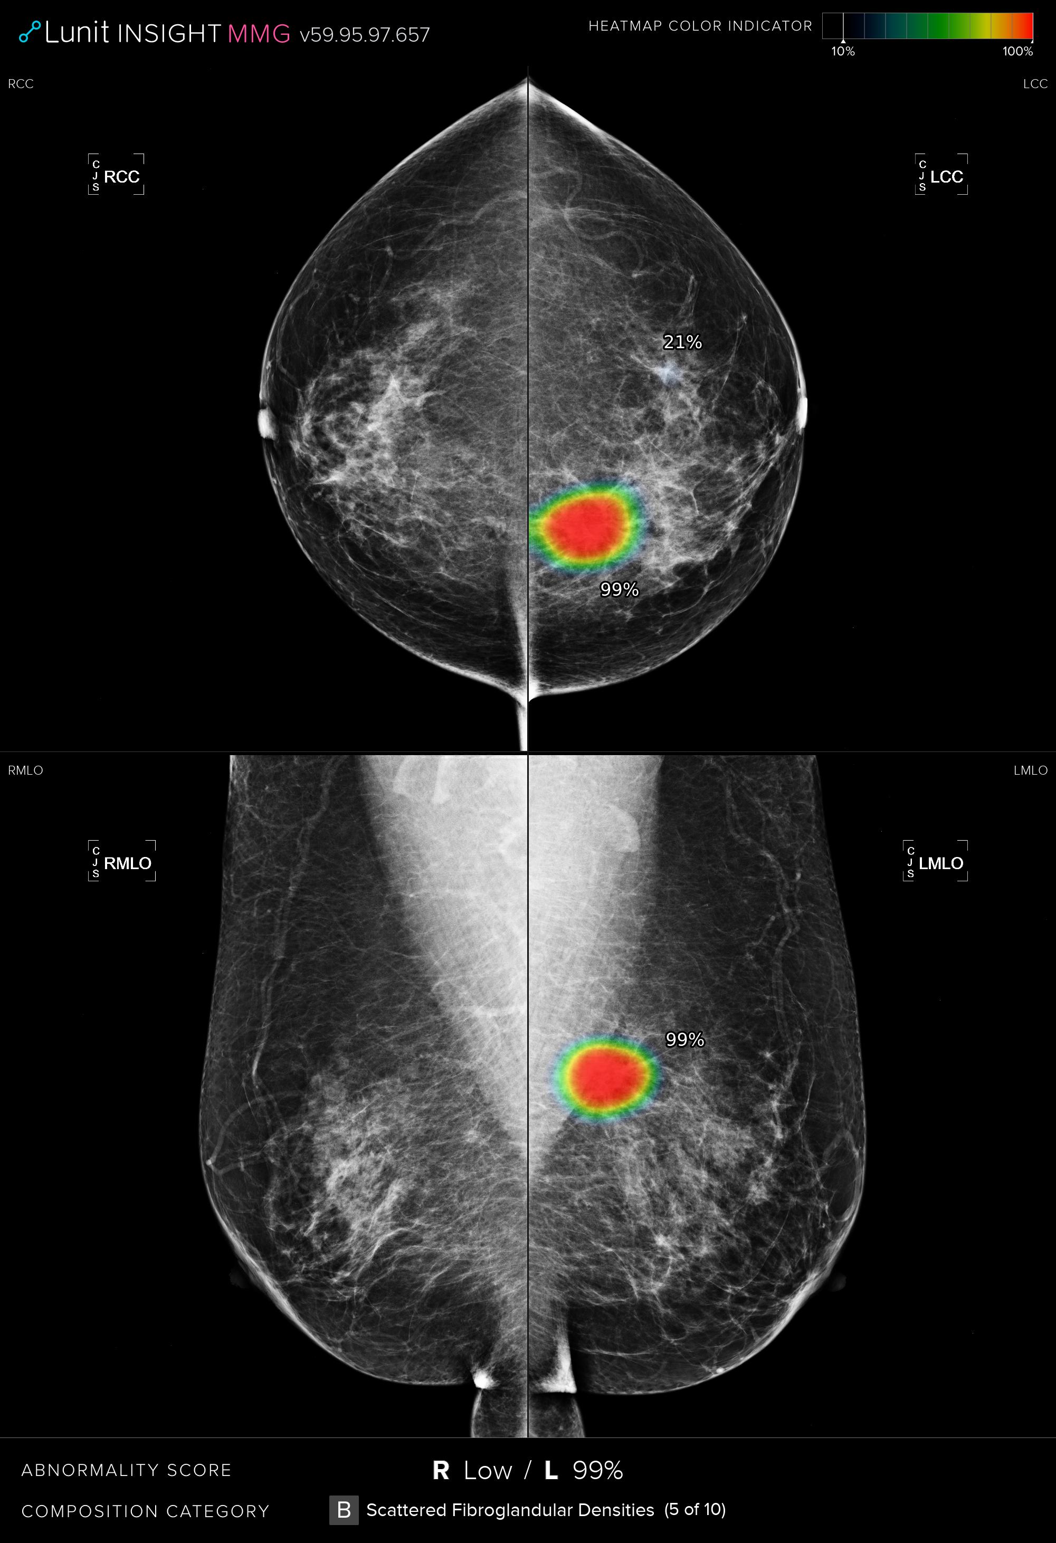
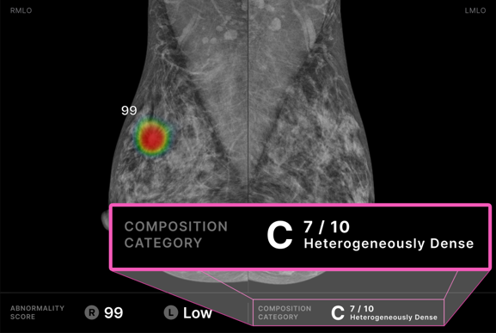
Notes:
Breast cancer is the most common cancer in the UK, making up around 15% of all cancer diagnoses. There are around 56,000 new cases of breast cancer each year and sadly around 11,000 deaths.
AI can be used to interpret a mammogram and with greater-than-clinician accuracy, identify and localise lesions - especially useful for surgical planning; measure breast density, which can be a prognostic indicator; classify and grade tumours which is essential for treatment.
That allows us to more quickly identify who has cancer, and potentially what type of cancer, so that we can treat them more quickly.

Slide 20
AI IN BREAST SCREENING
Manual double reader
Agree
Radiologist 1
Recall
Radiologist 2
No recall
Arbitrating reader
Notes:
You may know that we have three national breast screening programmes in the UK, across England and the devolved nations, that each use a double reader approach. Every mammogram is read independently by two radiologists and if they disagree then it goes to a third, arbitrating radiologist. The objective is to assess whether a patient needs to be recalled for further investigation or treatment for suspected breast cancer.
The problem with that, of course, is that there's a terrible shortage of radiologists in the NHS and that means that there is a backlog of breast cancer screening cases. Patients aren't being screened as often or as quickly as they should and that results in cancers being diagnosed at a later stage where it's more difficult to treat, or missed altogether.

Slide 21
AI IN BREAST SCREENING
Manual double reader
Agree
Radiologist 1
Recall
Radiologist 2
No recall
Arbitrating reader
AI independent reader
Agree
Radiologist 1
Recall
AI
No recall
Arbitrating reader
Notes:
An approach we're trialling in Scotland, as part of the iCAIRD programme, is to replace one of those radiologists with AI.

Slide 22
BREAST SCREENING
Results from a variety of product vendors whose product is routinely applied to process mammography data
50
%
45
%
Reduction in the number of breast radiologists, helping to reduce workforce and recruitment pressures
Automation of the entire national breast screening process
40
%
12
%
Of breast cancer patients could be diagnosed earlier, some more than 2 years earlier.
More fatty breast cancers and 5% more dense breast cancers were diagnosed
Notes:
We think we can automate 45% of the process using this approach, and at the same time relieve the significant workforce and recruitment pressures. That automation will help us diagnose 40% of breast cancer patients earlier, some as much as 2 years earlier, and pick up 12% more fatty breast cancers.

Slide 23
Heart failure pathway
Notes:
Heart failure accounts for 5% of healthcare spending in Scotland, which is 3-4 percentage points higher than in most other developed countries. Around 80% of heart failure occurs late in disease progression, normally when you've already presented at the emergency department. Clearly the earlier we can detect and treat the causes of heart failure, the better.
We know that the risk factors can be managed particularly in the community, but we don't have enough sonographers to carry out all the echocardiograms we would like and that means a lot of patients have to wait in a 12 month backlog and make unnecessary trips to hospital. It's also quite a complex clinical pathway, so there are lots of opportunities to improve efficiency.

Slide 24
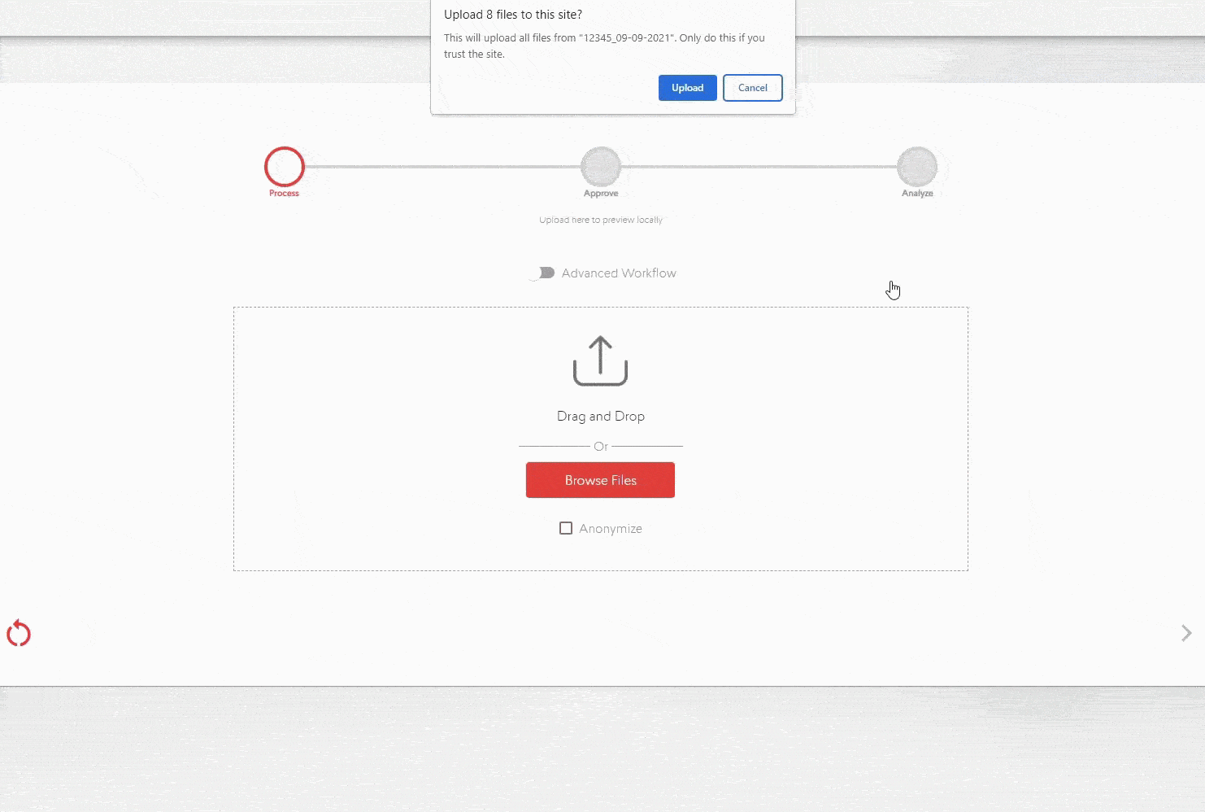
Notes:
In Scotland, the OPERA project uses AI to work out the risk of heart failure for a patient, using data that we collect directly from patients using a new app, and combining it with an AI rapid interpretation of a patient's echocardiogram.

Slide 25
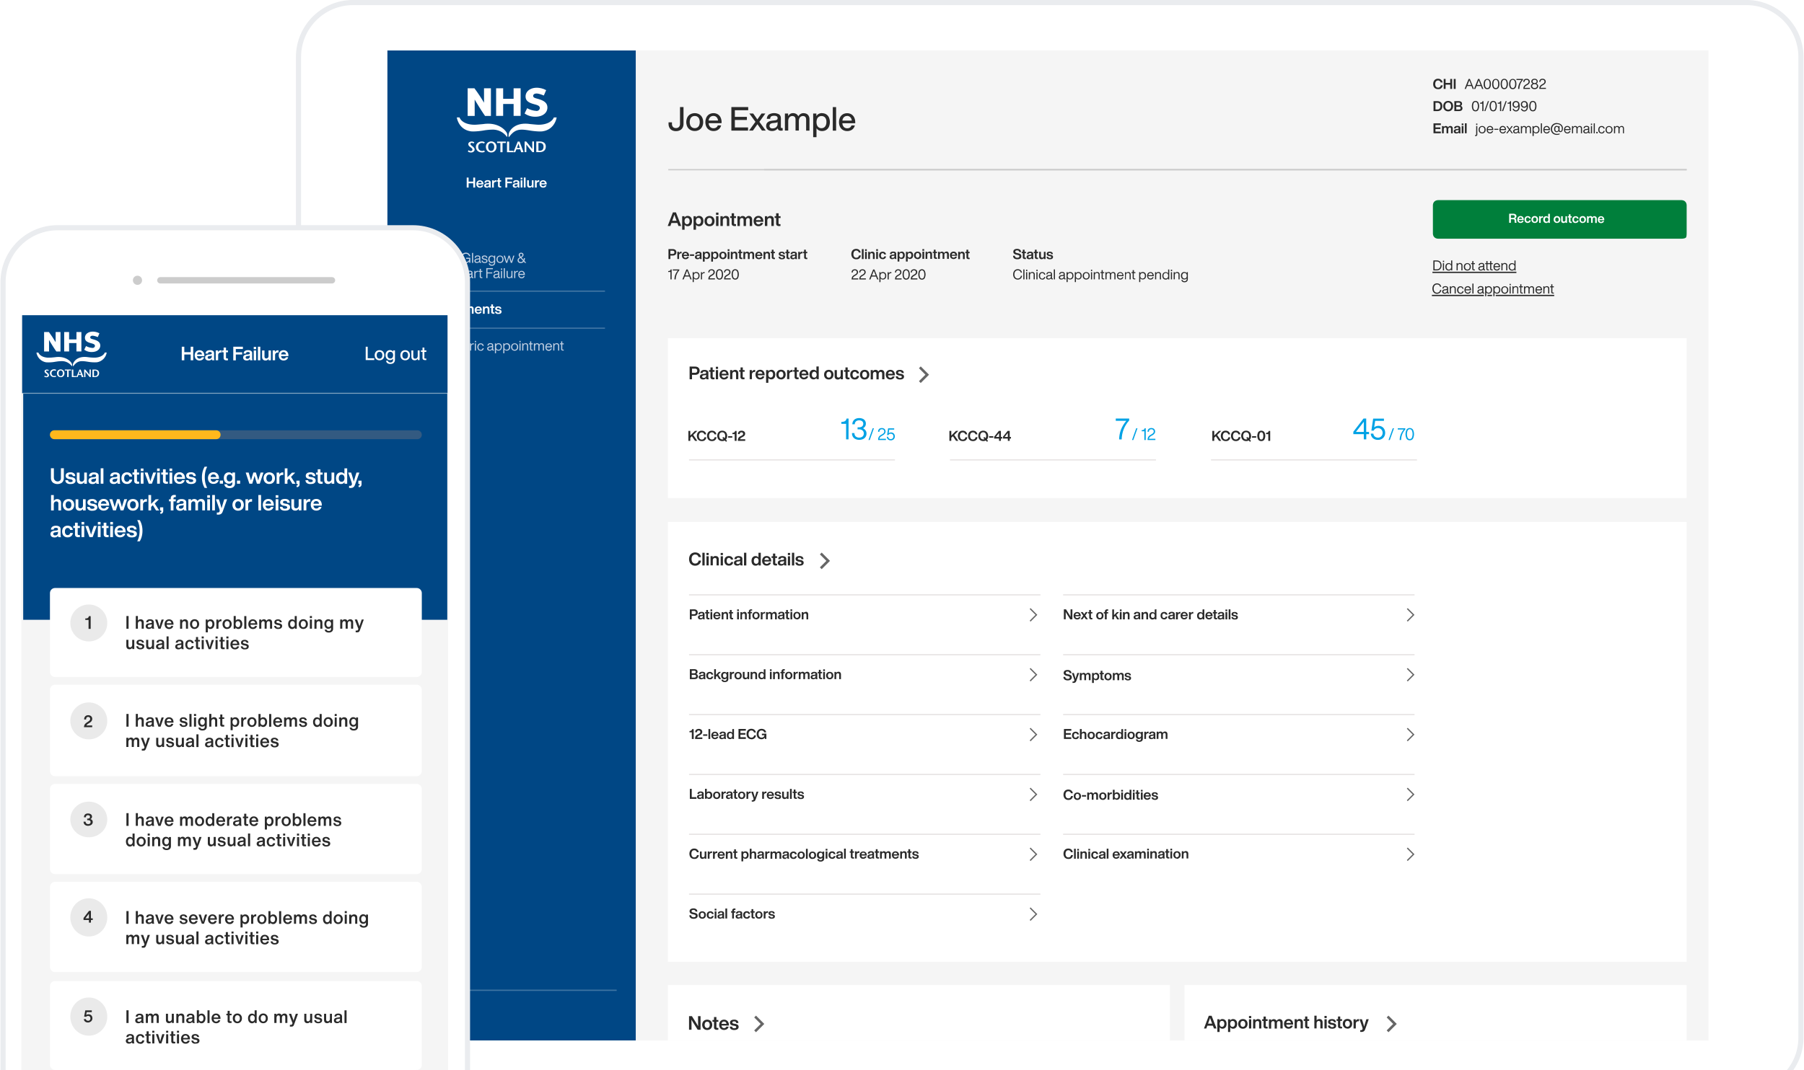
Notes:
All of that information is then presented to cardiologists using a new web-based application, and they can quickly determine the correct course of action for that patient before having to see them in person.

Slide 26
OPERA
Results from the Optimised Pathway for Early Identification of Heart Failure in the Community (OPERA) project - a collaboration between AstraZeneca UK, NHS Greater Glasgow & Clyde, University of Glasgow, Lenus Health and West of Scotland Innovation teams
2
weeks
2
minutes
Waiting time reduced from 12 months to 2 weeks for a population of 1.2 million
Echo analysis times reduced from 25 to 2 minutes by operationalising AI tools
30
%
150
%
Referrals diverted by enabling active clinical referral triage (ACRT)
Increase in diagnostic efficiency based on patients diagnosed in a 4hr clinic
Notes:
The benefits here are just amazing. We reduced the patient waiting time from over 12 months to just 2 weeks. It now takes just 2 minutes instead of 25 minutes to interpret the echocardiogram and by doing all of this in the community, we've been able to reduce the number of patients who have to come to hospital, by 30%. That's an overall gain in efficiency of 150%

Slide 27
Prostate histopathology
Notes:
Another area in which there been a recent proliferation of AI tools, is prostate histopathology.
Prostate cancer is the most common cancer amongst men in the UK. There are around 52,000 new cases of the cancer every year and around 12,000 deaths. The sooner it's diagnosed, the greater the chances of survival, so anything we can do to speed up the diagnostic process is a good thing.
Histopathology, for those who don't know, is the science of understanding disease by looking at human tissue. So when you get a biopsy, the piece of tissue is send to a lab, who use a microtome to shave very thin 3 micron slivers of that tissue and fix it onto a glass slide.

Slide 28
Notes:
9 health boards in Scotland now have the capability to scan that glass slide at 40 times magnification and store it digitally. Once it's stored in this format, we can process it easily using AI. On the iCAIRD programme, we digitised the pathology lab at NHS GGC and now around 98% of all histopathology slides are scanned - about 600,000 slides every year.

Slide 29
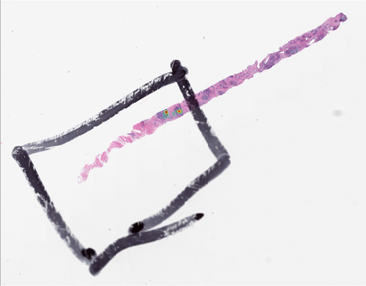
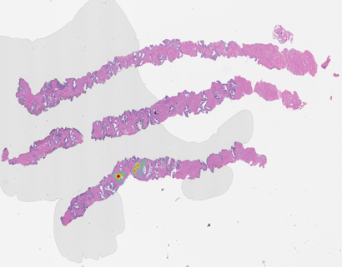
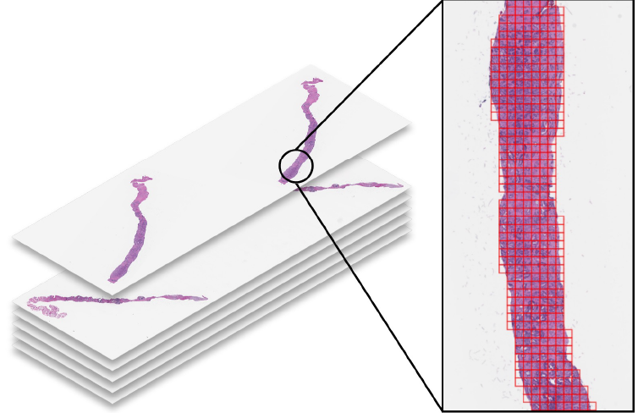
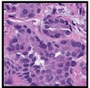
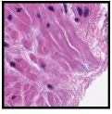
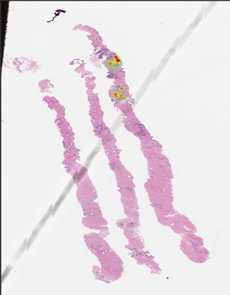
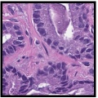
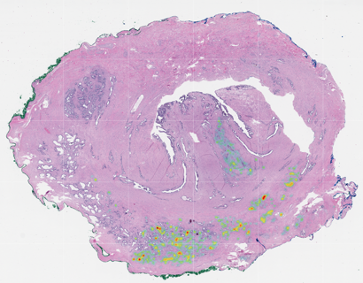
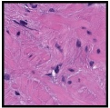
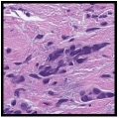
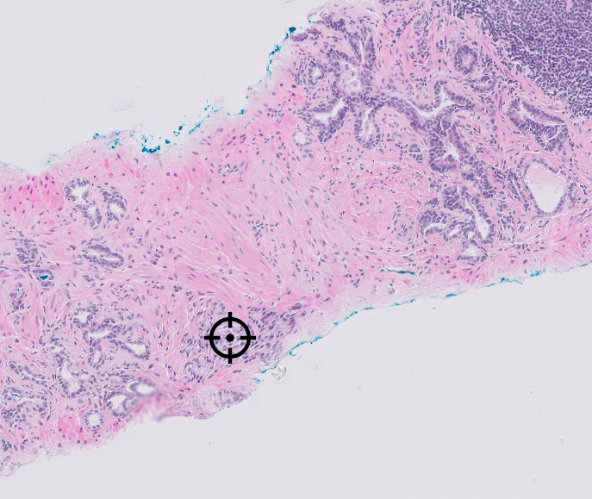
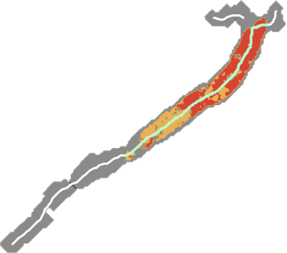
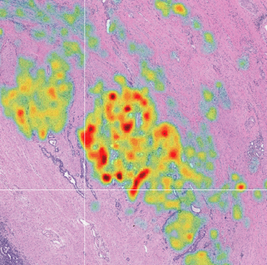
Remove artefacts
Detect and assess disease features
Select slides
Tissue length
Gleason 4
Gleason 3
Tumour length
Measure
Grade
Highlight
Identify and heatmap
Notes:
We apply AI throughout the process of interpreting each slide.
In the first instance, we use AI to look at the digital image and tell us if it's of acceptable quality. In the top left of the screen you can see some examples of unacceptable quality. Somebody has drawn on the slide with a pen, there a fold in the tissue, it's out of focus or there's contamination on the slide itself.
Once we've weeded out the slides that cannot be used, we process all the slides for a patient, by breaking it down into smaller tiles - something we call tessellation - look at each tile for evidence of cancer and select only the slides that we suspect have cancerous tissue.
Then we use AI to determine the boundaries of the tumour - a process we call localisation or segmentation - and we automatically measure the size of the tumour, compared against the size of the tissue sample that we have on the slide. We also grade the cancer. And finally, we use heatmaps and other visual cues to help pathologists see the cancer.

Slide 30
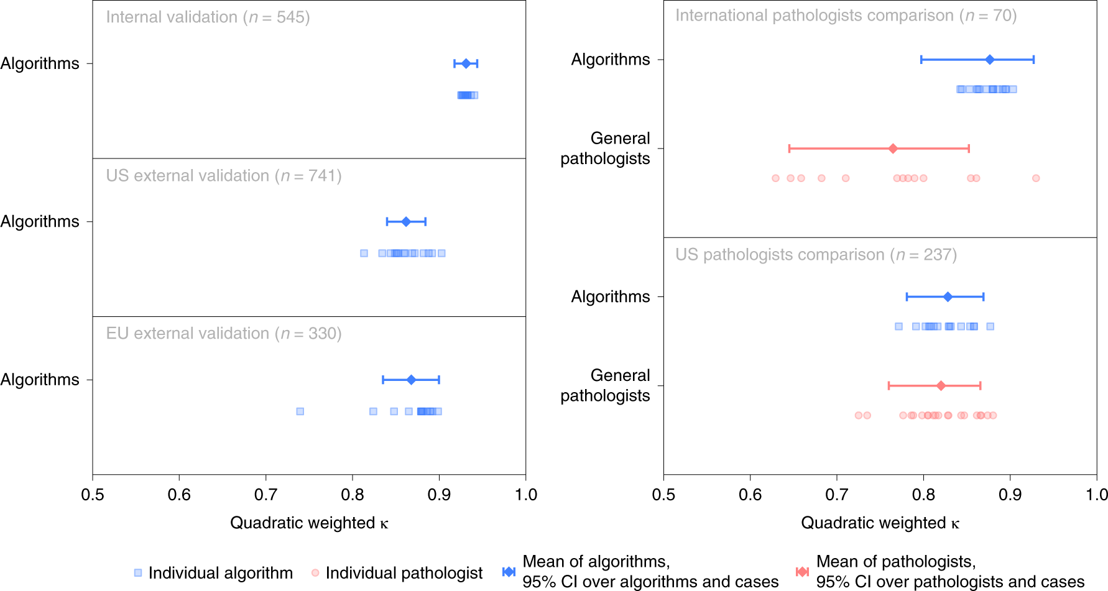
VARIABILITY:
AI vs PATHOLOGIST
There is higher agreement and less variability between AI algorithms and the reference standard
If you put 10 pathologists in a room, you might get 6 different gradings
If you put 10 algorithms in a room, you might get 3 different gradings
Low variability means more consistent diagnosis, but not necessarily more correct diagnosis
Artificial intelligence for diagnosis and Gleason grading of prostate cancer: the PANDA challenge
Notes:
As many of you will know, we use the Gleeson system to grade prostate cancer. It's renowned for having what we call high interobserver discordance - basically if you put 10 pathologists in a room, you'll get maybe 6 different grades instead of one.
A global grand challenge has recently finished, where they had a number of pathologists Gleeson grade a series of digital H&E images and then did the same with a number of different AI algorithms. What they found was that without tuning the AI to the dataset, there was a higher agreement with the reference assessment and lower variability between algorithms. In essence - if you put 10 algorithms in a room you might get 3 different grades instead of 6 - and if you put one algorithm in the room, you'll get the same answer every time.
Lower variability means more consistent diagnosis, but it doesn't necessarily mean more correct diagnosis.

Slide 31
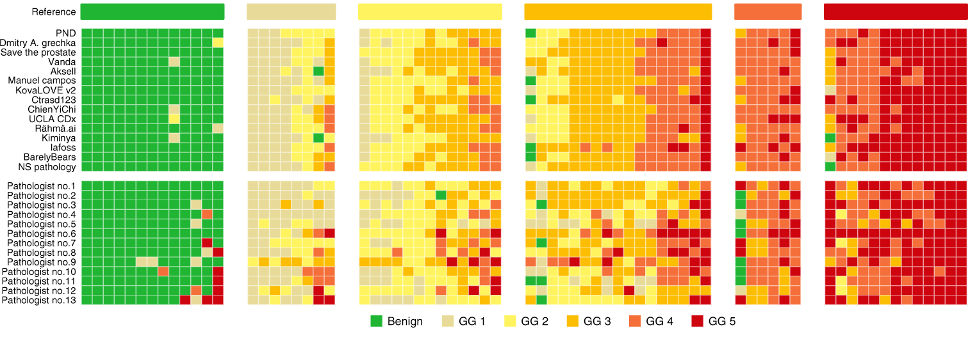
ACCURACY:
AI vs PATHOLOGIST
Artificial intelligence for diagnosis and Gleason grading of prostate cancer: the PANDA challenge
Notes:
The same grand challenge also looked at accuracy against a reference grade. You can tell straight away, that it can be a bit of a lottery, but the AI is both more consistent and more accurate - in some cases, more accurate by 7 percentage points.
In fact, whereas the US pathologists missed 7.3% of cancers, the AI missed just 1.9%, and overall pathologists missed 1.9% of cancers versus just 1% with AI.
Interestingly, AI tends to overgrade mid-grade tumours and pathologists tend to undergrade high-grade tumours. The solution is to combine AI and pathologists, and to tune the algorithm to the local dataset.

Slide 32
PROSTATE CANCER
Results from various peer-reviewed journals on the performance of the Paige Prostate product
7.3
%
65
%
Increase in the detection of prostate cancer from histopathology slides
Reduction in patient time-to-diagnosis
70
%
25
%
Reduction in false negative diagnoses of prostate cancer
Improvement in accuracy of Gleeson grading
Notes:
This whole AI process takes between 30 seconds and a minute; a 65% reduction in the time to diagnosis. At the same time, we're able to achieve a 7% increase in the detection of cancer and a 70% reduction in false negative detection. Overall we see a 25% improvement in the accuracy of Gleeson Grading. In a lab such as NHS GGC, all of those improvements taken together might be an equivalent of saving 1-2 pathologists.

Slide 33
Hospital command centre
Notes:
We often talk about the clinical value of AI, but actually a huge amount of the time and money spent on a patient relates to the their journey through an episode of care. How long does it take to transfer them to a bed, is a bed even available, are they in a hospital with the right people and skills for their particular condition, how efficiently do we run our operating theatres and can we get them seen by a surgeon quickly, how quickly are they discharged, etc, etc.

Slide 34
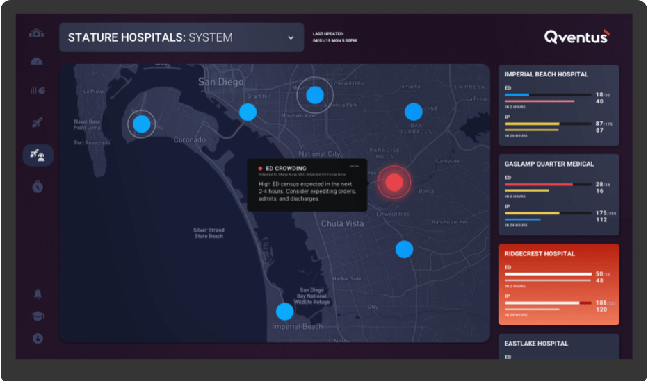
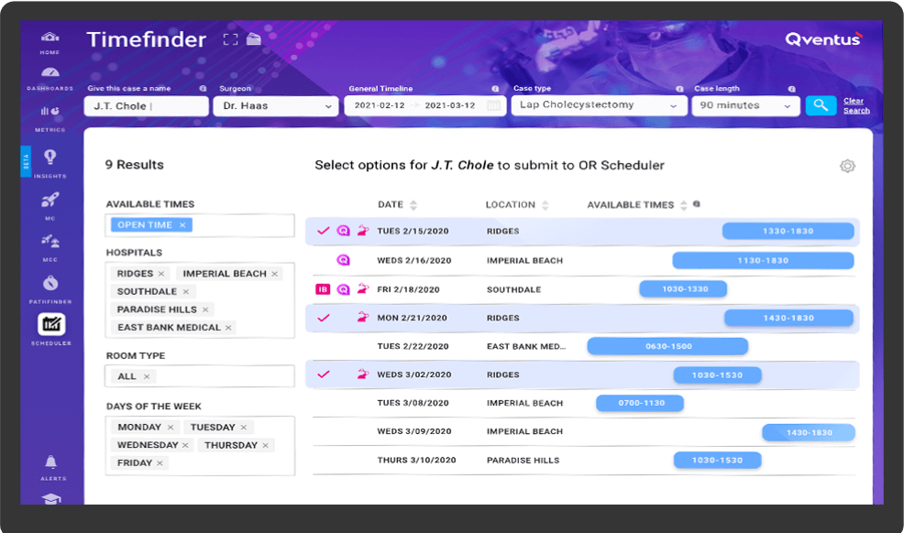
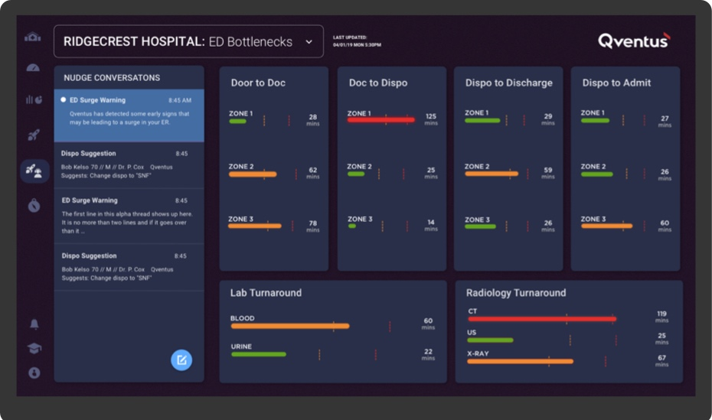
Notes:
There is an entire market for command centre technology that will automate many aspects of running a hospital and where it can't automate, it will ensure that you have the right information to make a decision.
As you're arriving in the emergency department AI is being used to help triage and assess, to look for space in the right ward, to roster the correct number of staff to deal with the influx of patients and to optimise discharge planning so that there's a bed there when you need it.
Simultaneously, for a health board like GGC, it might assess the capability, capacity and availability of clinical specialists across all the hospitals within the health board and based upon patient condition, suggest that they be redirected to a different hospital.
AI is used to manage equipment logistics, not only making sure the right equipment is in the right place at the right time, but also that it's moved from one place to the other by the quickest route and that somebody is there to move it.

Slide 35
OPERATIONS
Performance claims from multiple vendors of hospital command centre, patient flow and capacity management tools
200
%
20
%
Increase in morning discharges (before 11 am)
Reduction in the length of stay within the emergency department
20,000
days
23
%
Annual reduction in excess hospital stays
Reduction in the time it takes to transfer a patient from ED to an inpatient bed
Notes:
These command centre solutions are used more in the US than they are in the UK, but I've heard rumours that the new Monklands hospital in North Lanarkshire is considering one.
Now, there were just too many benefits to put on a single slide, but I've selected a few to give you a flavour of where these systems make a difference.
We all know that bed availability is an issue. Using AI we might be able to double the number of morning discharges and save 20,000 unnecessary days in hospital every year.
Earlier, you saw the national performance statistics with respect to the emergency department. 100% of patients brought into A&E should be admitted, transferred or discharged within 4 hours. We're currently doing that for just 71% of patients. Using AI we could reduce the length of stay in the ED by 20% and accelerate transfers out of the ED by 23% … now that might bring us closer to our targets.
In the US, Tampa Bay hospital which is probably about two thirds the size of the Queen Elizabeth hospital in Glasgow, saved $40m dollars a year in efficiency gains through a combination of AI and operational intelligence, using a command centre solution.
I reckon we could find a good use for $40m dollars in the NHS, don't you?

Slide 36
Emergency response
Notes:
Every year the Scottish ambulance service takes 1.4 million calls and responds to 750,000 unscheduled care incidents of which around 500,000 are emergencies - many of them a suspected heart attack or stroke for which time is of the essence. Like every service across the NHS, they are unable to keep up with demand, so any efficiency gain or performance improvement makes a significant difference and potentially saves lives.

Slide 37
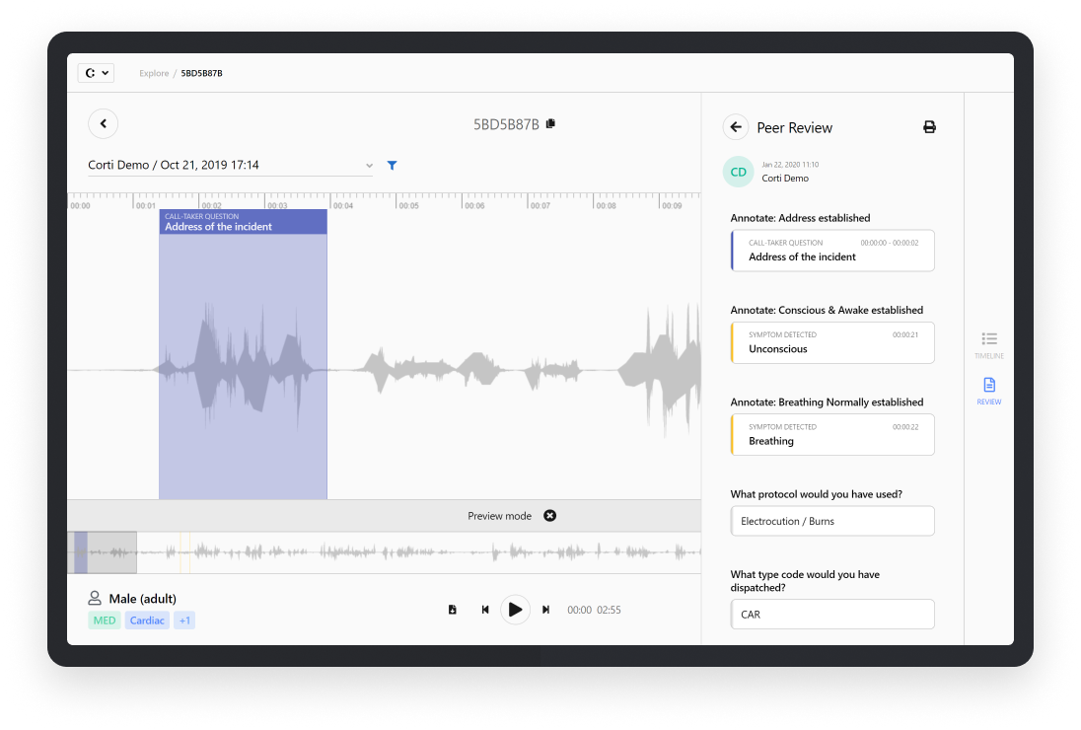
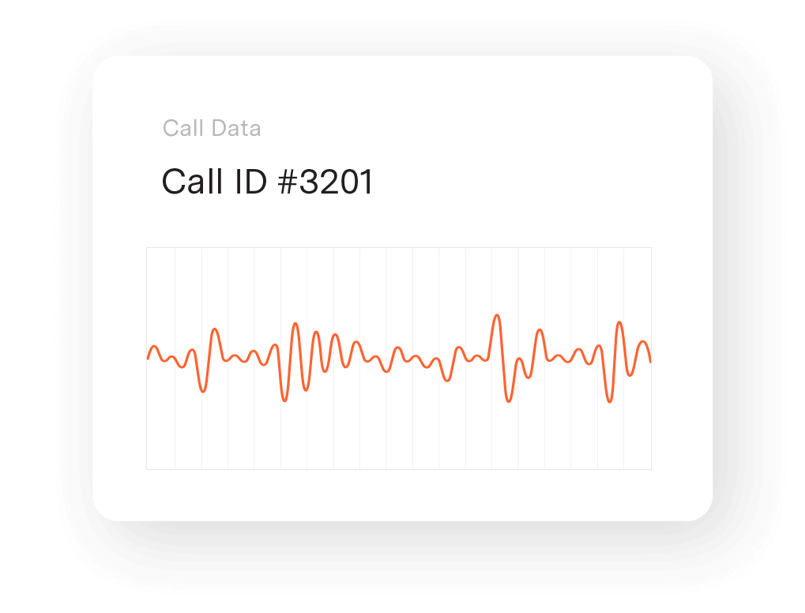
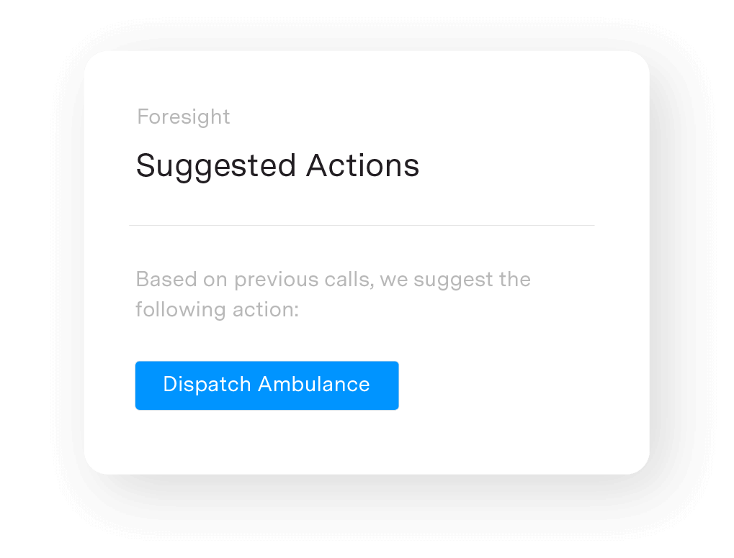
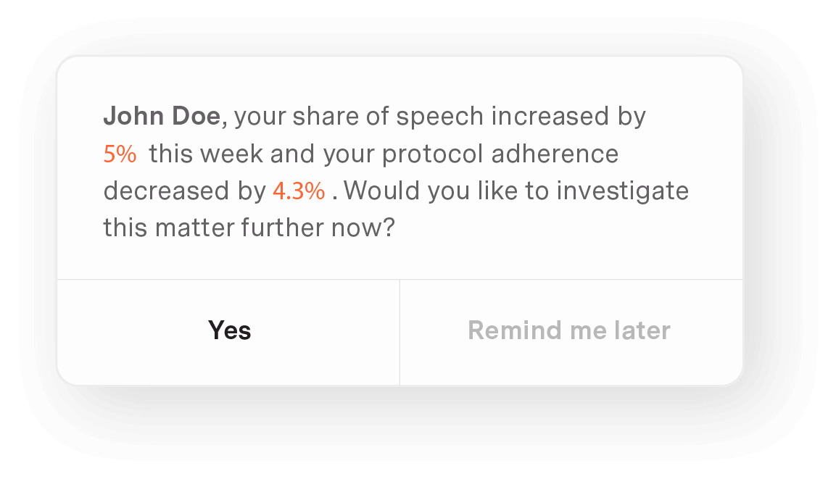
Notes:
The service has been trialling the use of AI within its call handling processes with technology from corti.ai. The tech is actually pretty amazing. The AI listens to the call, searching for key words and phrases, and listening to tone and emotion. In combines insights from that speech data with information that the call handler is typing into the application and identifies the category and type of incident, but also a suggested response, taken from the written protocols used by the call centre.
At the same time, the AI is measuring call handler performance - checking that they're following their protocols and looking for ways to continuously improve their response so that they can give the right advice in the shortest time possible.

Slide 38
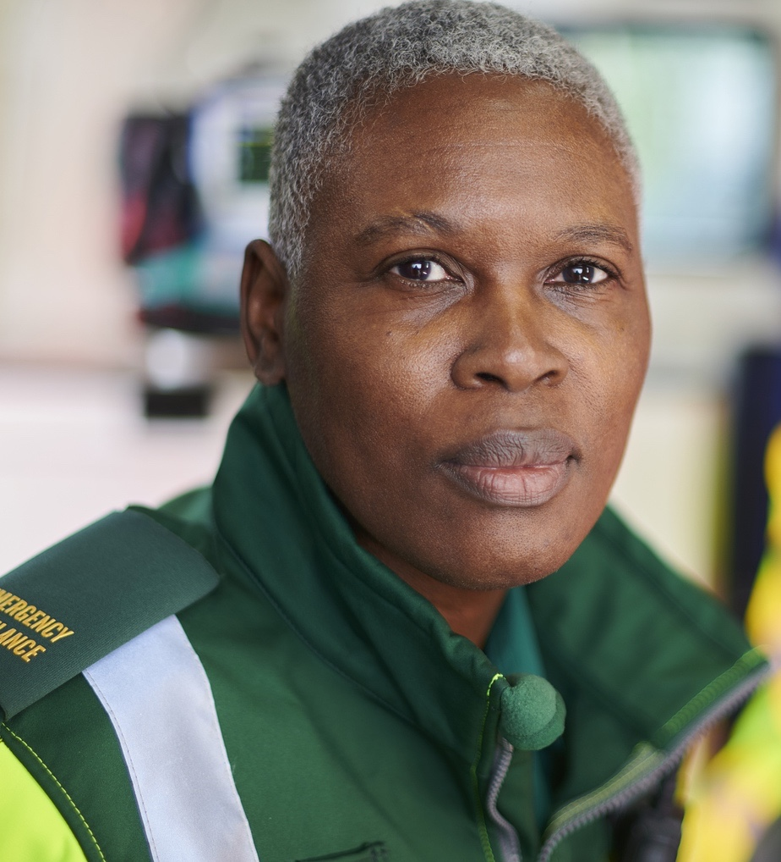
EMERGENCY RESPONSE
Performance claims from multiple vendors of hospital command centre, patient flow and capacity management tools
43
%
50
%
Reduction in undetected out-of-hospital cardiac arrests
Reduction in the error rate of call-handlers
3
x
25
%
Faster identification of performance issues amongst call-handlers and 50% increase in call evaluation
Increase in pace of call-handling
Notes:
By using this type of AI technology, we could reduce call handler errors by half whilst increasing the rate of call handling by a quarter. At the same time, call handlers can learn and improve 3 times faster than using traditional methods and the time it takes to independently evaluate their performance could reduce by half.
Perhaps of even greater interest is that the service could improve its diagnosis of out-of-hospital cardiac arrest by 43%, which means more patients get the right treatment when they're travelling to hospital and once they're transferred into the care of the emergency department.

Slide 39
Traffic management
Notes:
Now you might be thinking, what the hell does traffic management have to do with healthcare. Well, let me tell you. I actually own a company called Simplifai that uses artificial intelligence to manage the flow of traffic across a city, by automatically changing traffic signals to achieve whatever goal you set for the system.

Slide 40
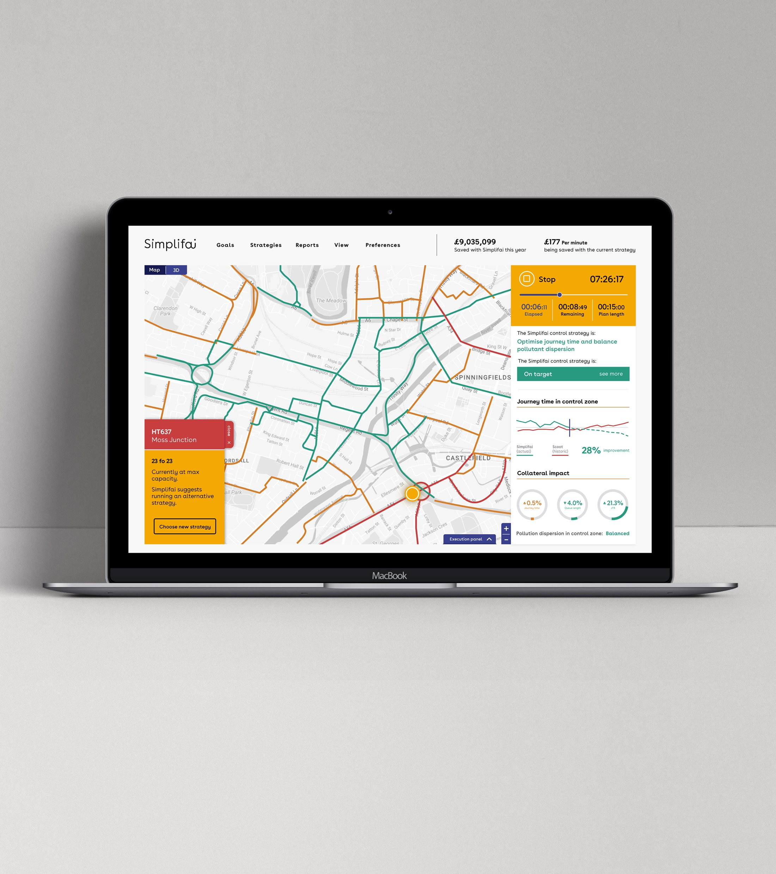
Notes:
In many cases, the goal is to reduce congestion and resolve traffic jams. We could certainly use it in the M8 rush hour traffic. But the goal can be anything. Redirect traffic in the event of an accident, evacuate the city in the event of an incident, better manage the inflow and outflow of traffic from a hospital during shift changeover or, as we'll discuss now, reduce local air pollution.
As an example, Glasgow Royal Infirmary in the north of Glasgow sits just off a very busy part of the M8 motorway. It's common to see large queues of slow moving or even stationary traffic at the motorway junction leading to the hospital…and unfortunately, because of where the hospital is situated, particulates from vehicle emissions blow off the motorway and pool around the hospital. I've heard stories about people who left their windows ajar when they went on holiday and when they came back, everything in their office was coated in a fine layer of soot emitted from vehicles on the motorway.

Slide 41
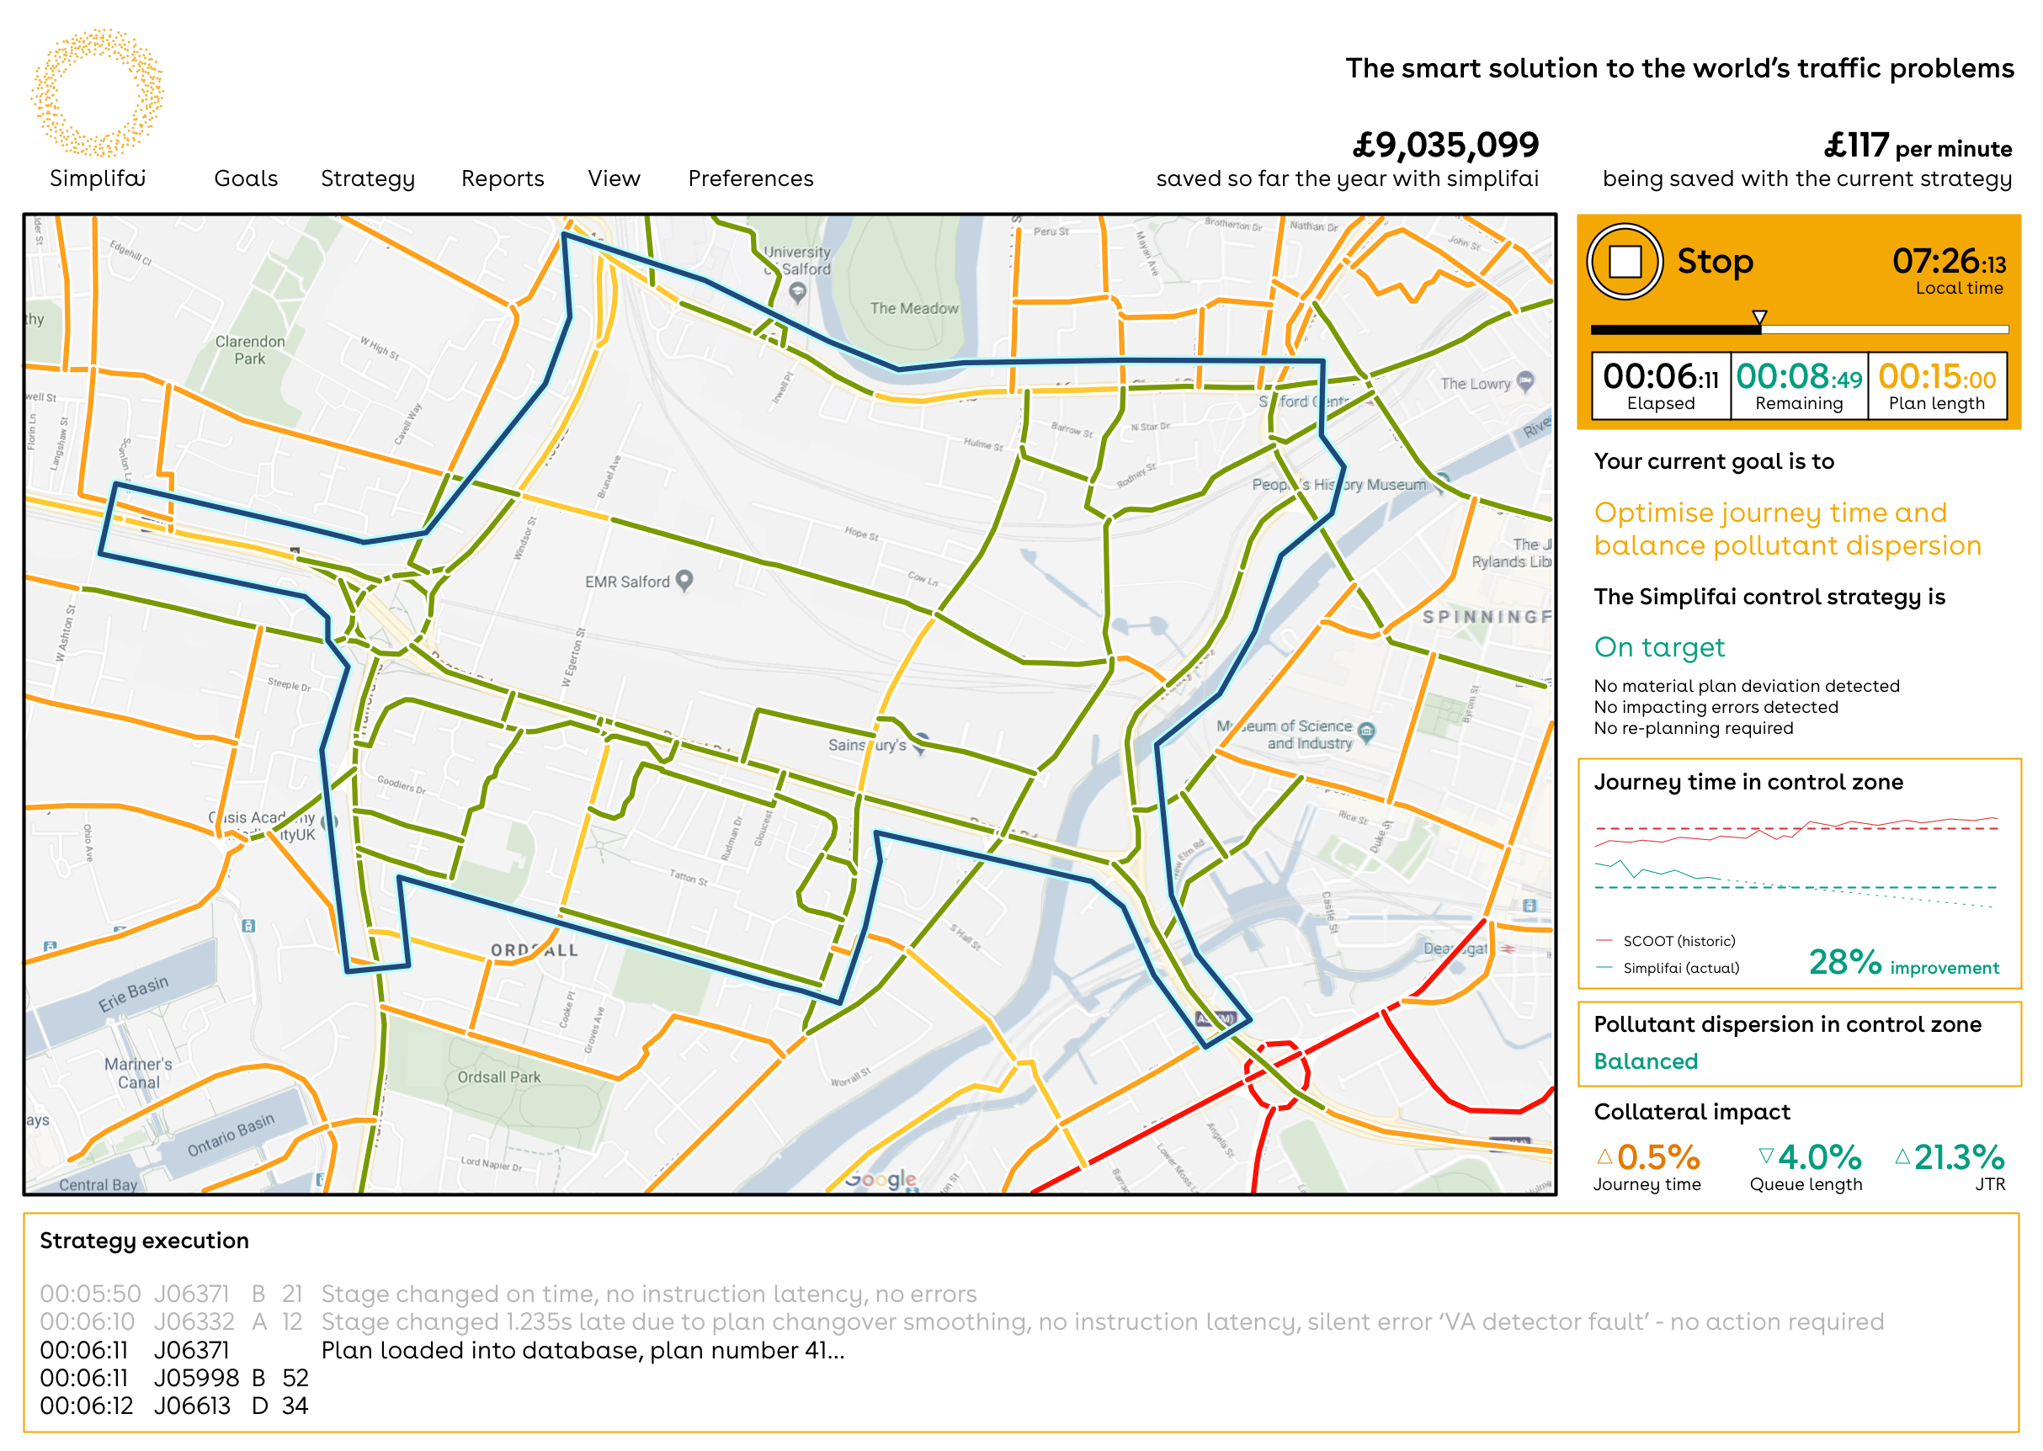
Notes:
Now just imagine - workers, patients and the public are breathing in those particulates - and that stuff isn't good for you.
So we can use AI to look at the volume, flow and direction of traffic, combined with weather data and information on the prevailing wind flows. We can then set a goal for the system, of minimising air pollution in the areas immediately adjacent to the motorway and ask it to continuously adjust the traffic lights across the city to optimise traffic flow and reduce carbon particulate emissions.

Slide 42
TRAFFIC MANAGEMENT
Projections based on theoretical performance, estimates from offline trials of the Simplifai software, and limited real-world trials
20
%
10
%
Reduction in congestion and improvement in journey time, in and around hospitals
Reduction in particulates that are likely to adversely affect human health
1000
lives
Saved every year in the UK alone through air pollution reduction
Notes:
Now if we do that, not only do we get a reduction in congestion of 20%, but we can reduce those particulates by 10%, and by managing air quality more generally, save 1.000 lives in the UK every year.

Slide 43
Predicting and improving outcomes
Notes:
Now, AI is most often used for diagnostics, but probably a more interesting and perhaps useful application of the technology is in prognostic and predictive medicine. I see a trend where big pharma is paying for AI to be used in companion diagnostics - particularly digital biomarkers and their ability to predict the effectiveness of drug treatment - basically, personalised and precision medicine. In clinical practice, we're beginning to see AI used as a risk assessment and outcome prediction tool.

Slide 44
Notes:
Much like the heart failure project I talked about earlier - we have a world-renowned project running in Scotland called DYNAMIC-AI, which combines artificial intelligence with digitisation of the COPD pathway - that's chronic obstructive pulmonary disease. We have a high prevalence of COPD in Scotland and sadly, a high rate of mortality - owing to our lifestyle.
What Chris Carlin and the team at NHSGGC have done, working in partnership with a company called Lenus, is to first of all start gathering data directly from patients - what we call patient reported outcomes. They do that using a phone app, and they prompt for people to enter their information using wearable technology like a fitbit or apple watch - something that's always at hand. They also provide a means for the patient to communicate directly with care staff using a chat application and provide self-management toolkit - which means they get the help they need without having to come into hospital wherever possible.
The team then combined traditional medical information from the patient's electronic health record, with that new patient reported information and surfaced that information in a series of dashboards to the wider clinical team, but especially the respiratory consultant responsible for the patient's ongoing medical care. Only the information relevant to treatment is displayed and those most at risk of decline or who need immediate intervention, can be surfaced more quickly - to accelerate decision making.
Now - having gathered all of the patient information together, a suit of AI algorithms is used to provide additional risk information - such as the risk of readmission within 3 months, the risk of mortality within 12 months, and other measures that indicate a change in prognosis based on your data.
The result is a reduction in 12 month mortality from 33% to 17% and readmission after 335 days rather than 40. A 54% reduction in admissions and a £3.38m reduction in cost per 500 patients.

Slide 45
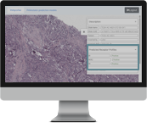
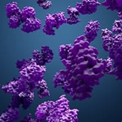
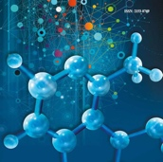
PROGNOSTIC BIOMARKERS FROM H&E
Genomic
Proteomic
H&E Slide
Transcriptomic
Metabolomic
ER, PR, HER2 and Ki67 in breast cancer
Notes:
Traditionally, immuno-histochemical tests would be required to assess many prognostic biomarkers. I'm aware of at least one product that assesses ER, PR and HER2 directly from H&E slides without the need for further IHC testing, and another that will do the same with Ki67.
Since they are prognostic, faster biomarker assessment allows clinicians to provide more accurate patient information and more immediate, targeted therapies.

Slide 46
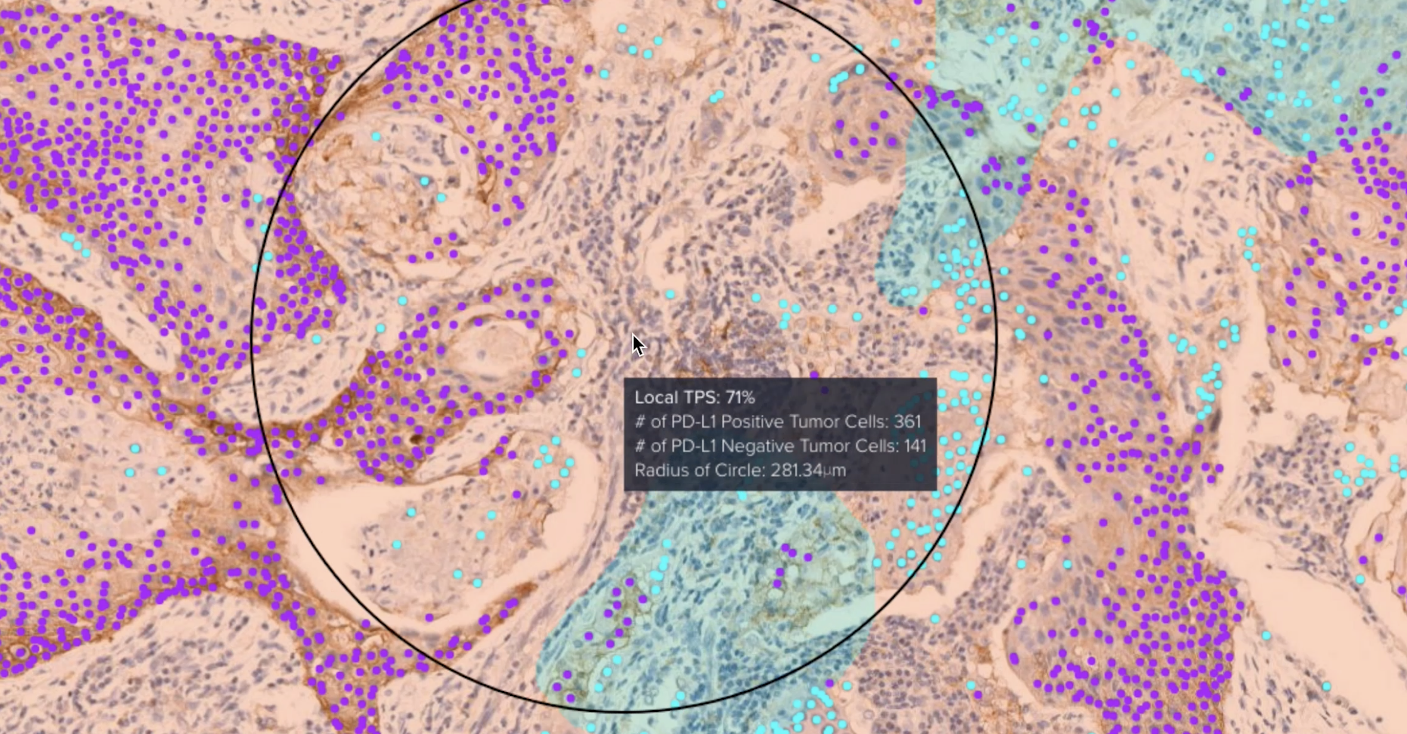
PD-L1 FOR IMPROVED IMMUNOTHERAPY
Notes:
Similarly, AI will provide a highly accurate quantification of PD-L1 expression using automated tumour proportion and combined positive scores, from H&E slides and can identify up to 50% more patients that would be receptive to immunotherapy.

Slide 47
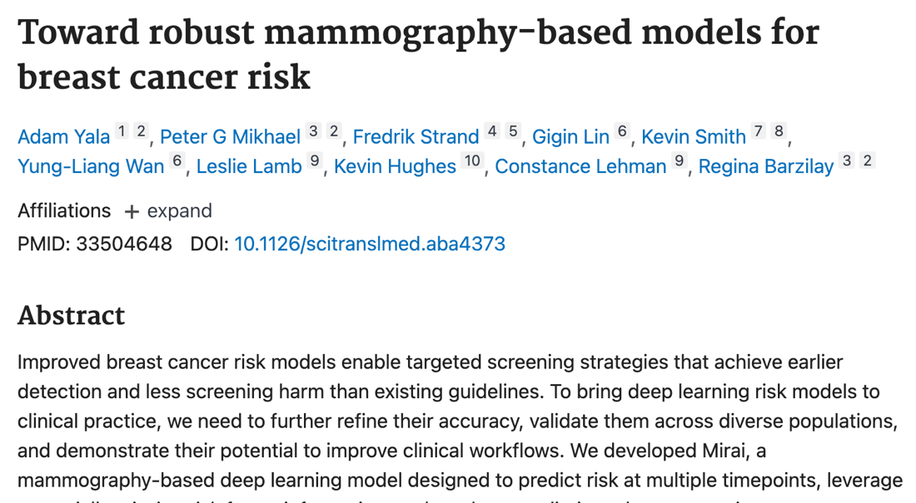
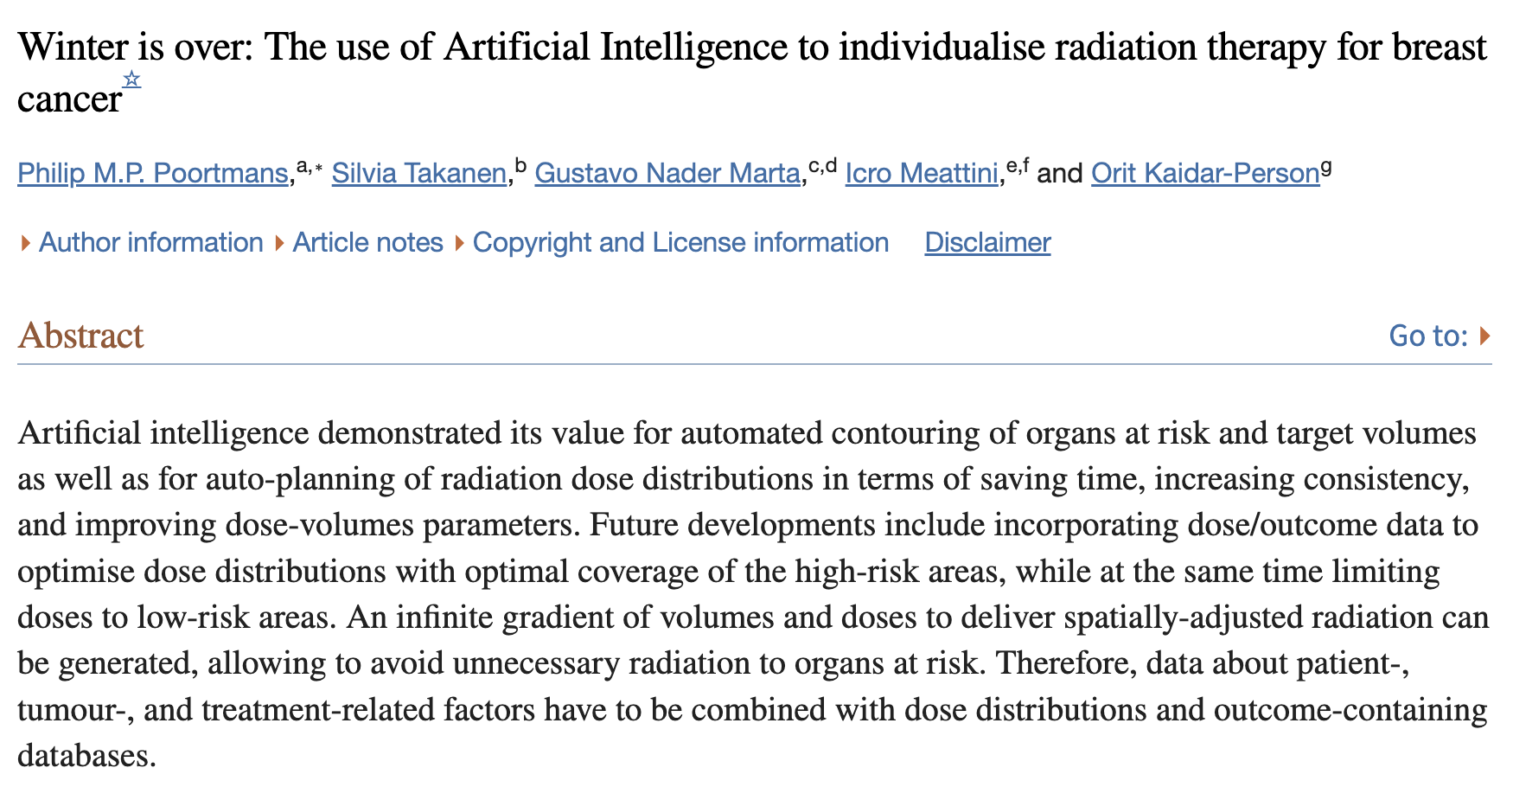
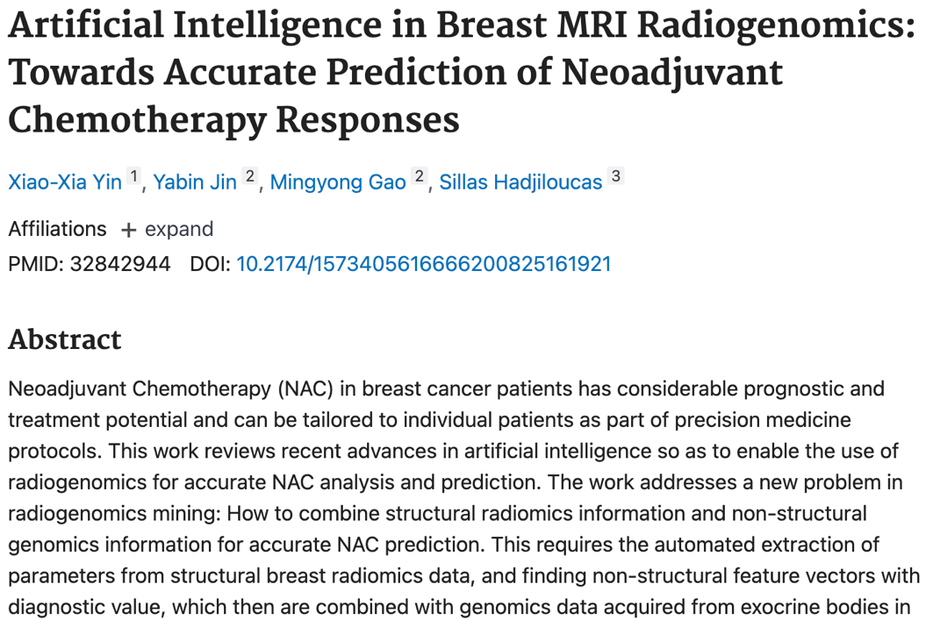
RISK MODELS AND TREATMENT PLANNING
Notes:
Now, although there are no at-market products that do what's indicated on this slide, there is a healthy pipeline of late-stage and translational research that demonstrates AI, by using a combination of non-imaging and imaging data, could achieve a 25% improvement in the detection and prognosis of high risk cancers.
In the US, for example, a Cancer Centre is using natural language processing to read a patients unstructured medical notes to understand whether sentinel lymph node biopsy might be appropriate in early stage cancer patients
Using a combination of structural breast radiomics data and genomics data extracted from exocrine bodies, an AI model has been able to predict response to neoadjuvant chemotherapy.
In radiation therapy, AI automates the production of anatomically individualised target contouring, and improves inter-observer agreement for small-sized volumes.
It can also optimise dose distributions and prescriptions for individual patient anatomies, in a fraction of the time that it takes to do so manually - showing time reductions of 85% from nearly 3 hours to just 30 minutes.

Slide 48
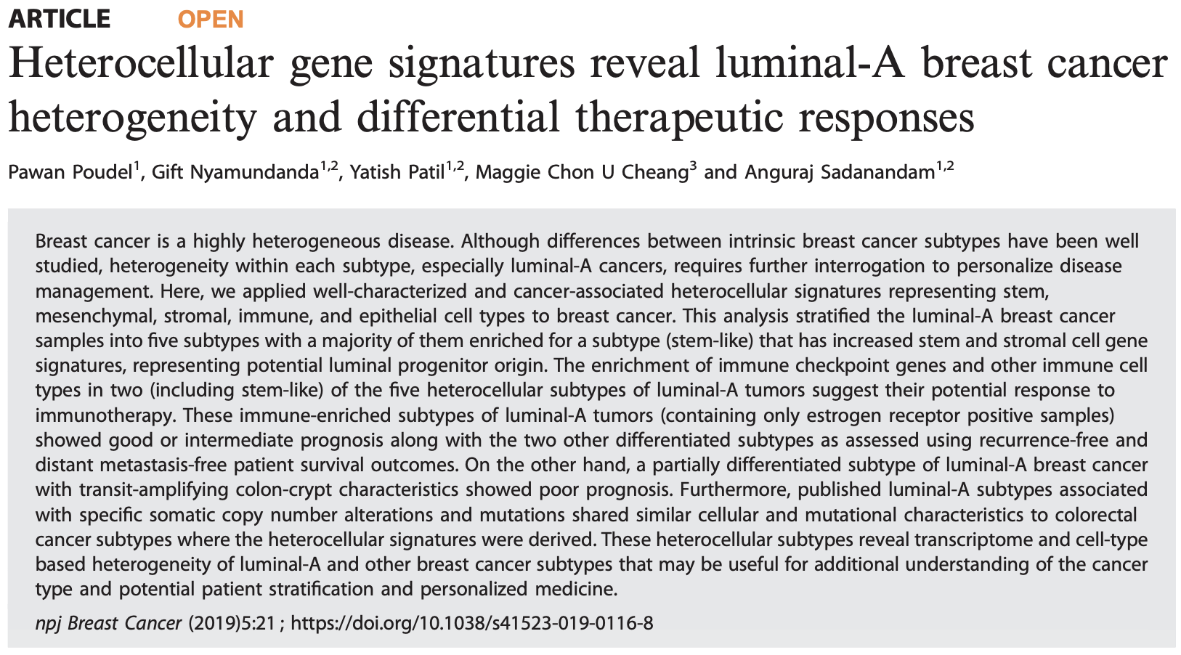
NEW CANCER SUBTYPES
Notes:
The Institute of Cancer Research in London is working on an early breast cancer gene signature study, following their success with a similar study in bowel cancer
They've used AI to analyse genomic, cellular and molecular data to uncover 5 new subtypes within luminal-A breast cancer
This is more than simply automating the task that a clinician can already perform. These subtypes are not perceptible with the human eye and rely upon multi-omic data for differentiation.
They're important, because two of the subtypes respond more positively to immunotherapy than the others, allowing for precision therapy. Another has been shown to be prognostic regarding the therapeutic effectiveness of tamoxifen.

Slide 49
A dose of reality
Notes:
Hopefully, like me, you're excited by the prospect of everything I've shown you this evening. But you guys work in insurance, so I think a good dose of reality and perhaps a little skepticism should help balance the mood.

Slide 50
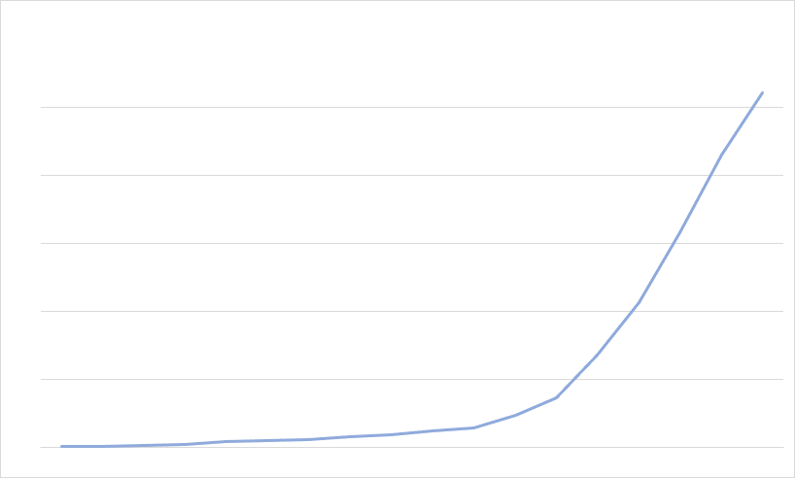
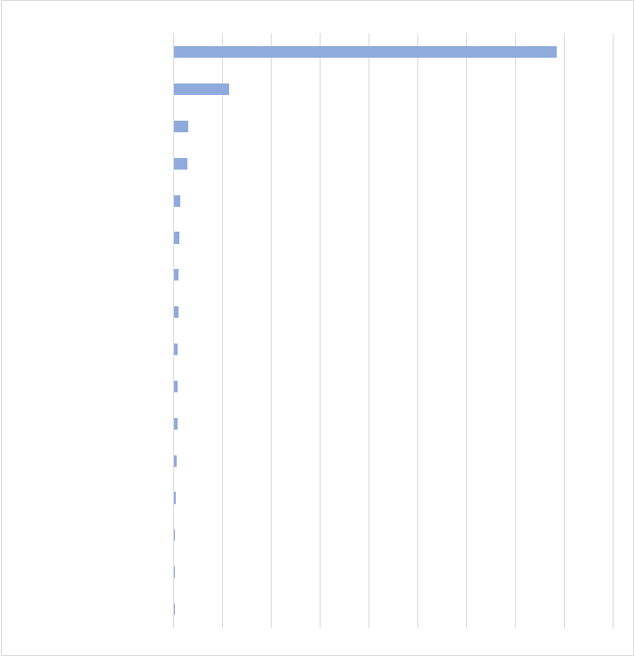
RATE OF INVENTION
75
%
11
%
of all FDA-registered software medical devices are in the field of radiology
of devices are in the field of cardiology, which is the second largest category
Notes:
We're fortunate that in the US, the FDA is now publishing its database of device registrations. The EU hasn't done the same, but EU registrations follow a similar pattern with a slightly higher number of registrations because the regulatory process isn't as burdensome. But the stratification by clinical area is much the same.
Around 75% of all registrations in the US are radiological AI tools; about 80% in the EU. They provide clinical decision support to radiologists - largely clinical feature recognition, volume measurement, triage and prioritisation.
You can see that around 5 to 6 years ago we hit a tipping point in radiology that led to the familiar hockey-stick growth curve. We are at a similar tipping point in pathology as laboratories across the world move to digital pathology systems, and vast volumes of data start to become available for research. That means over the next 5 to 6 years we're going to see a similar growth in pathology AI. I can see similar trends in cardiology, opthalmology, dermatology, oncology and a host of other areas.

Slide 51
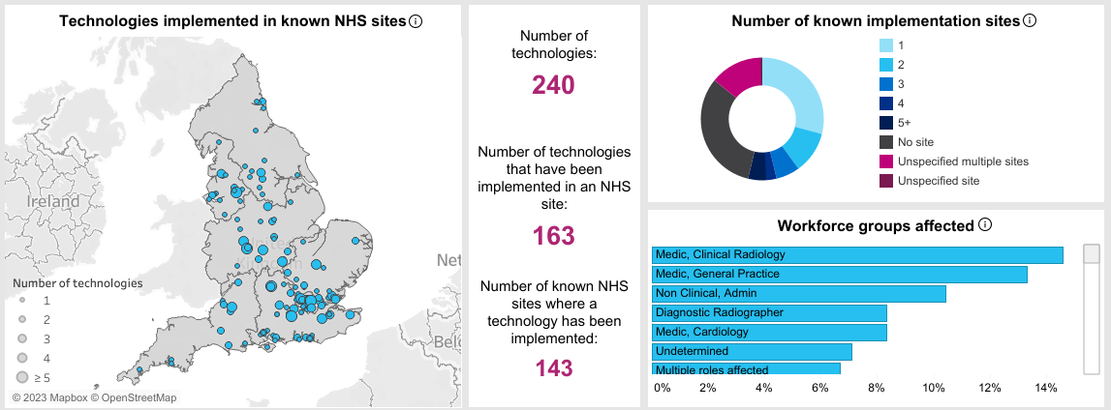
RATE OF ADOPTION:
SPREAD
Notes:
But here's the rub. Just because you get regulatory approval for your product, doesn't mean that is works. And the nature of AI is that even if it works in, say America, Israel, China or India … doesn't mean it'll work in the UK.
So there is a gap between products being available and products being adoptable.
NHS England have created a dashboard showing the rate of adoption of AI into clinical service. Now this slide is encouraging. 240 technologies implemented in 143 sites. We need to look a little closer though, to see the real picture

Slide 52
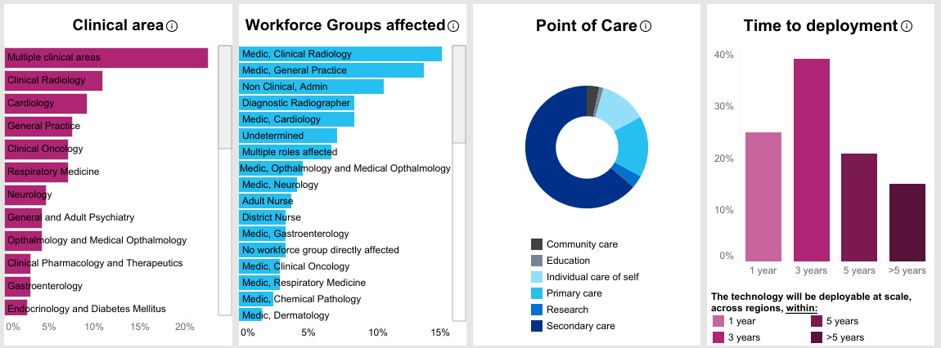
RATE OF ADOPTION:
TYPE
Notes:
You can see on the right that 75% of AI products are 3 to 5 years away from deployment; around 25% are forecast to be adopted in 1 year or less. The reason for this is actually very simple - we have to gather prospective evidence in clinical use of the performance and benefit of these technologies before we can fully adopt them into service, at scale. These health technology assessments take between 12 and 36 months to complete, depending on the complexity of product integration into the clinical pathway.
So we'll have to wait a while for AI to become mainstream.
The great news is that we've learned a lot of lessons from AI in radiology. So now, as products become available in other clinical areas such as pathology, we're already starting to conduct those prospective assessments. Actually, I suspect we'll be ready to adopt the first pathology AI in Scotland within 24 months.
We're already nationally procuring a stroke thrombectomy solution for all health boards and through our accelerated national innovation adoption pathway we're evaluating AI for detecting lung cancer.
So whilst AI isn't ubiquitous in clinical care, the near-term future looks very promising and if you invite me back in 24 months, I suspect there I'll have a long list of stories - well, maybe a short list - about how we're actually transforming healthcare using AI

Slide 53
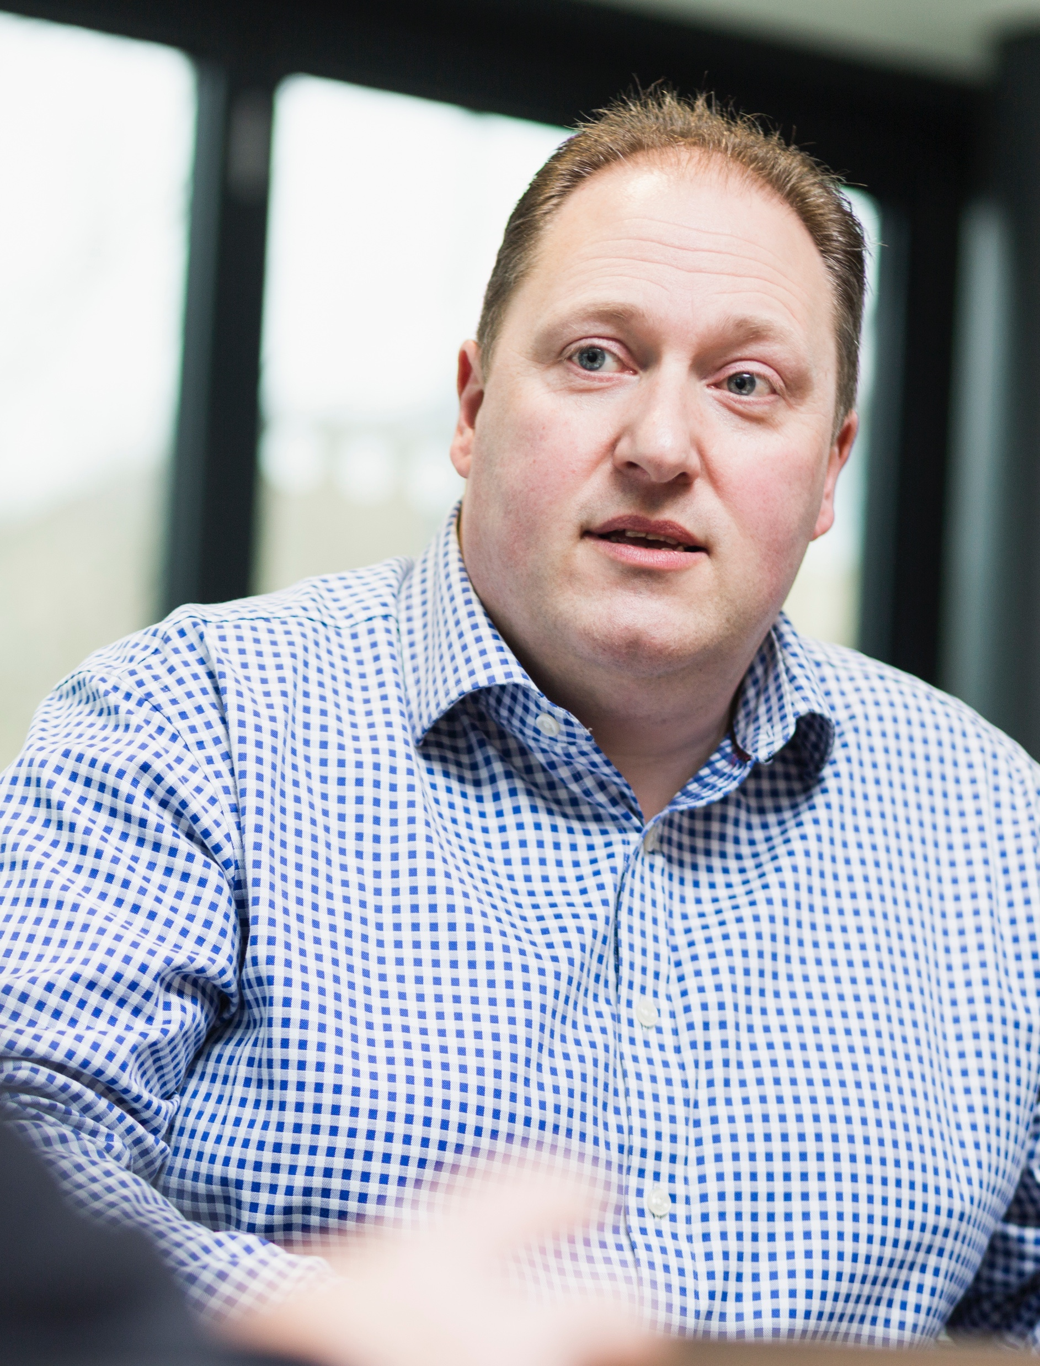
JD Blackwood
CTO, iCAIRD
Healthcare AI Lead, Scottish Government
james.blackwood@ggc.scot.nhs.uk
james.blackwood@gov.scot
linkedin.com/in/james-blackwood/
Notes:
I want to thank you for your time and for the invitation to speak this evening…and whilst I'm sure everyone is desperate to have dinner … If you have any questions, I'd be pleased to answer them.

